Slide 1
TorchDrug安装
创建环境 conda create -n TD python=3.7
安装pytorch conda install pytorch=1.8.0
安装torch-scatter conda install torch-scatter
安装rdkit conda install -c conda-forge rdkit
下载TorchDrug https://github.com/DeepGraphLearning/torchdrug
安装requirements.txt中的其他库
安装TorchDrug python setup.py install

Slide 2
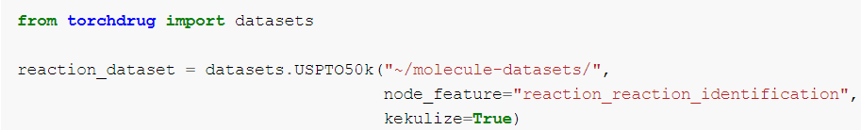
TorchDrug框架
以 Tutotial 给出的 Center Identification 为例
Knowledge Graph Datasets (FB15k, WN18…)
Molecule Property Prediction Datasets (BACE, BBBP…)
Retrosynthesis Datasets (USPTO50k)
Citation Network Datasets (Cora, CiteSeer)

Slide 3
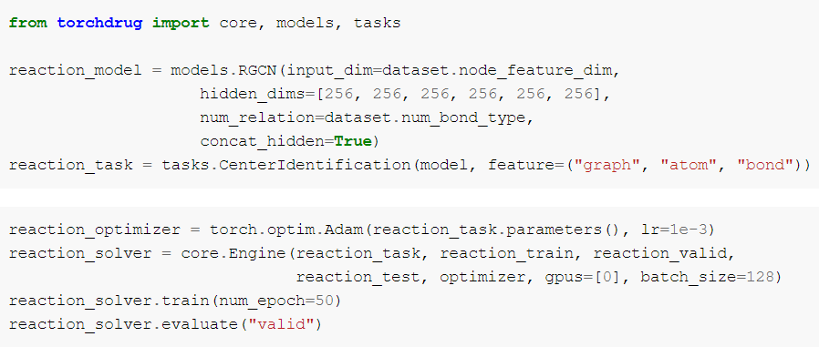
TorchDrug框架
模型
Knowledge Graph Embedding (TransE, DistMult…)
Graph Neural Networks (GCN, RGCN…)
Normalizing Flow (GraphAutoregressiveFlow)
Self-supervised Models (InfoGraph)

Slide 4
TorchDrug框架
任务
Property Prediction Tasks
Pre-trained Molecular Representation Tasks (EdgePrediction)
Molecule Generation Tasks
Retrosynthesis Tasks

Slide 5
TorchDrug框架
管线

Slide 6
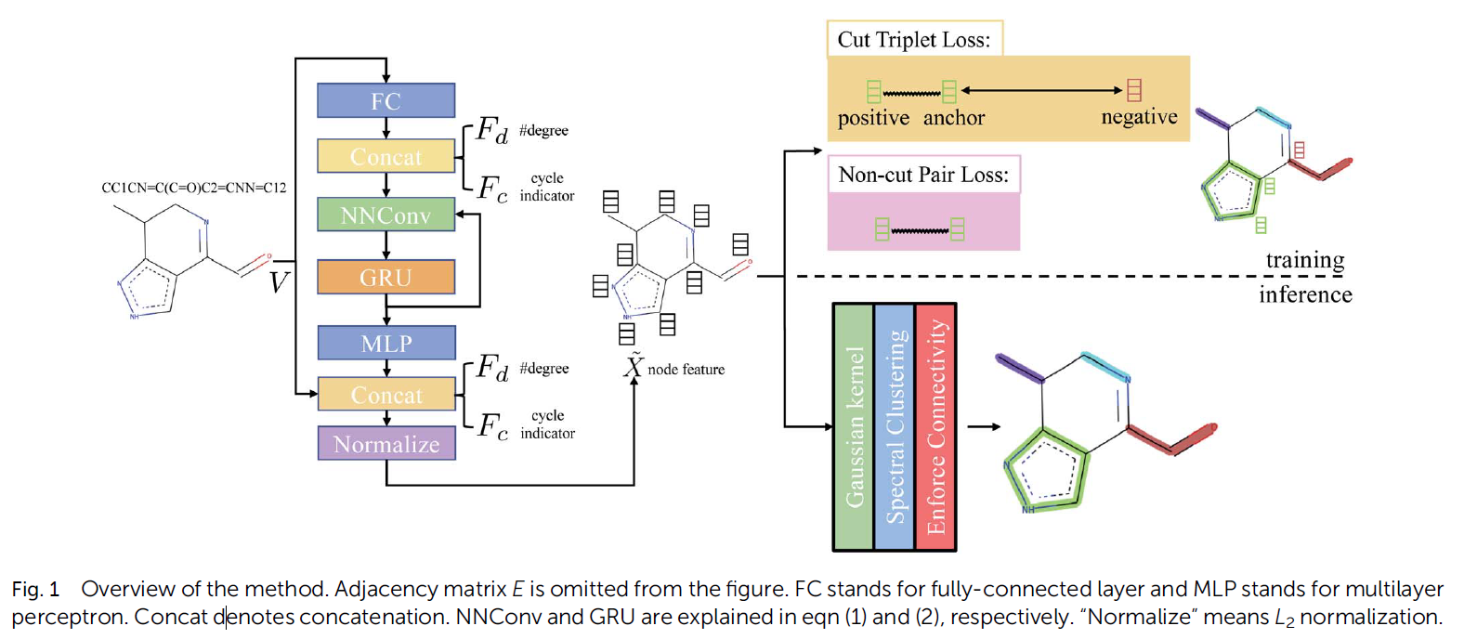
进展
Graph neural network based coarse-grained mapping prediction
Dataset: Human-annotated Mappings (HAM) dataset

Slide 7
未来工作
实现上述 baseline
构思idea

